Slide 1
ORGANISING
BY,
C.HELEN JOSEPHINE
S.SNEHA
V.RATHNA PRIYADHARSHINI

Slide 2


ORGANISING
What is organising?
“organising in a general sense means systematic arrangment of activities”
Organising follows “planning”

Slide 3
DEFINITION
ALLEN defines “Organizing “ is the process of identifying and grouping the work to be performed defining and delegating resposibility and authority and establishing relationship for the purpose of enabling people to work most effectively together in accomplishing objectives”.

Slide 4
THEO HAIMANN
“Organising is the process of defining and grouping the activities of the entire process and establishing the authority and relationship among them”

Slide 5
ORGANISING IN MANAGEMENT
Organising in management refers to the relationship between people,work and resources used to achieve the common objectives

Slide 6
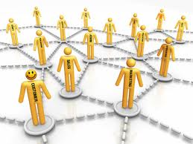

ORGANIZATION STRUCTURE
A DESIGN OF ORGANIZATION MOVEMENT OR BLUEPRINT,

Slide 7
DEFINITION
ORGANIZATION STRUCTURE EXPLAINS THE POSITION AND OFFICIAL RELATIONSHIP BETWEEN VARIOUS INDIVIDUALS IN THE ORGANIZATION.

Slide 8
ORGANISATION CHART
It is a diagrammatic representation of organization structure show names designation functions of personnel in a organization.

Slide 9
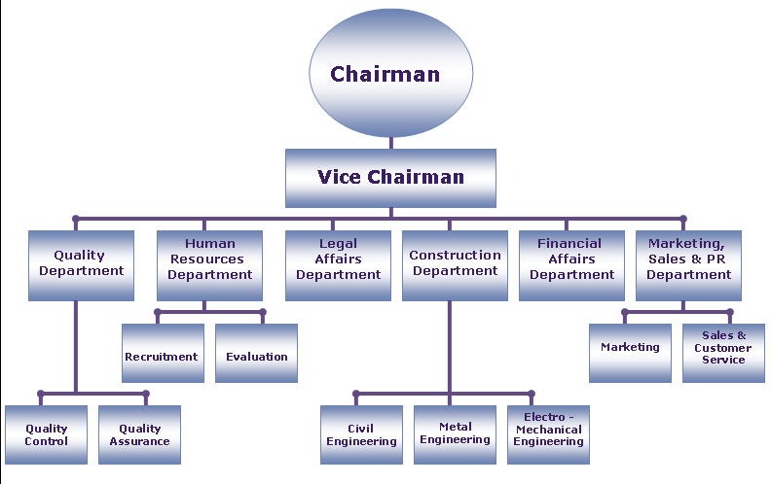

Slide 10

NATURE OF ORGANISING
Learning objectives
Identifying the task
Grouping the activities
Delegation of authority
Coordination

Slide 11
NATURE
Perform an analysis about the work
Identify the work
Organisation structure
The grouping of activities neccesary for attaining objectives(division of labour)
Assignment of work(communication)
Delegation of authority(authority structure)
Coordination

Slide 12
PURPOSE OF ORGANISING
Aids to management
It facilitates growth,creativity
It ensures optimum use resources
Establishes relationship among individual groups
Clusters job into units
Coordinates.

Slide 13

FORMAL AND INFORMAL GROUPS
FORMAL GROUP- A formal group is a structured group,which has a plan and positions each job’s objective and functions

Slide 14
CHARACTERISTICS OF FORMAL GROUP
Formal means something systematic.
It is in an official structure
It provides official relationship between individual.
It is objective oriented
It abides with rules and regulations

Slide 15

ADVANTAGES:
The line of communication is very clear
It is accuracy of the information.
systematic
It is objective oriented.
It has a heirarchial pattern

Slide 16
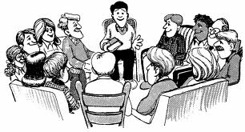
INFORMAL GROUPS
It is the outcome of personal ,social and friendly relationship and it develops spontaneously.
It arises naturally on the basis of friendship or some common interest which may or may not be related with work

Slide 17
DEFINITION
According to chester bernard “informal organisation is joint personal activity with our conscious common purpose though contributing to common purpose”

Slide 18
CHARACTERISTICS OF INFORMAL GROUP
Informal group is created by the member of the organisation for their social and psychological satisfaction
Informal groups are unstable in nature ,it is not permanent
Informal groups are greater in numbers than the formal groups
Free interaction

Slide 19

FORMAL GROUPS | INFORMAL GROUPS
It is concisiously deliberate in nature | It arises spontaneously
It is based on delegation of authority | It arises on account of social interaction or it arises from account of personal factors like friendship
Rules responsibilities are written and clearly defined | Just unwritten rules and regulations
It shown in organization chart | It has no place in organization chart
It provides a definite structure | It is structure less because it is social
Formal authority is attaches to a position | Informal authority attaches to a person out of social interactions
It flows downwards ( top to lower level) | It flows upwards
It is permanent and stable | It is temporary and unstable
It is deliberately impersonal | It is personal

Slide 20
TYPES OF ORGANIZATION STRUCTURE
LINE STRUCTURE
LINE AND STAFF STRUCTURE
FUNCTIONAL STRUCTURE
COMMITTEE STRUCTURE
PROJECT STRUCTURE
MATRIX STRUCTURE

Slide 21
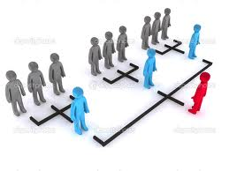
LINE STRUCTURE
It flows from top to lower level .
It is the simplest and oldest method followed in many organization.
It is also called as military organization.

Slide 22
GENRAL MANAGER
PRODUCTION MANAGER
ASSISTANT MANAGER
SUPERVISORS
WORKERS

Slide 23
MERITS OF LINE STRUCTURE
Simple and easy to establish.
Authority and responsibility is clearly defined
Prompts decision.
Speedy action taken.
Unity of command since each will have full control over subordinates.
Ensures Better discipline.
It is very economical since it is less elaborate.
It provides better scope for supervision.

Slide 24
DEMERITS OF LINE STRUCTURE
Lacks specialization
Overburden with lots of administrative work
It may result in autocratic control
Manager enjoys monopoly in the matter of decision making ( he himself take decision)
Always downward communications is possible
Lacks upward communication
It is suitable for small concerns employing few persons

Slide 25
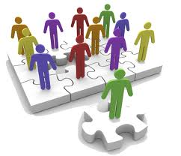
LINE AND STAFF ORGANIZATION
The staff is attached to line
The staff are experts specialized in specific areas
They give ideas to personnel
The staff supports the line personnel

Slide 26
MERITS OF LINE AND STAFF
Expert advice
Relief to top executives.
Quality decisions.
Flexible.
Specialization is not violated.
Unity of command is not violated.

Slide 27

DEMERITS OF LINE AND STAFF
Often arises conflicts between line and staff.
Leads to confusion since responsibility is not well defined.
Ineffective staff .
Suitability ( in large organization).

Slide 28

FUNCTIONAL ORGANIZATION
There will be a separate department for different actions or activities.

Slide 29
MERITS OF FUNCTIONAL ORGANIZATION
Simple and easy to understand
Specialization is possible
Makes clear division of aurithority
Flexible, easy to expand and contract.
Work load is less
Better control over subordinates
Scope for expansion
Higher efficiency

Slide 30
DEMERITS
Neglects specialists.
Overloads a few key executives.
Unity of command is violated.
Encourages dictatorial way of working.
Interdepartmental conflicts.
Delay in decision making.
Rigid and inflexible

Slide 31

COMMITTEE ORGANIZATION
A group of persons entrusted in a task
Types:
Standard or permanent committee.
Temporary or ad hoc committee.
Executive committee.
Advisory committee.
Formal committee.
Informal committee.

Slide 32
MERITS
Scope of group judgment .
Proper coordination and control among individuals and departments.
Motivation through participation is possible.
Various interest groups.
Check against misuse of powers.

Slide 33

DEMERITS
Expensive affair to constitute a committee
Time consuming or slow decision
Compromise decision
Suppression of ideas

Slide 34
PROJECT ORGANIZATION
It varies from one organization to organization.
Any organization execute a large project for a long period of time adopt this project organization.
Usually some company have large number of small projects.
The term leader organize the expert or specialist.

Slide 35
MERITS
Maximum use of specialized knowledge and skills.
Unity of command exist in this organization
Flexibility of operation.
Fixation of individual responsibility for results.
Focuses attention on the specific projects.
Provides better coordination.

Slide 36

DEMERITS
Difficulty in decision making.
Pressure and uncertainty due to some several specialist.
Difficulty in coordination.
Evaluation of performance of various specialist is difficult.

Slide 37
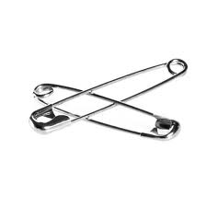
MATRIX ORGANIZATION STRUCTURE
It is suitable where there is large number of small projects.
It is also called as multiple command system.
It is also called as linking pins.

Slide 38
MERITS
BEST UTILISATION OF ORGANIZATIONAL RESOURCES.
BENEFIT TO BOTH FUNCTIONAL AND TECHNICAL SPECIALIST .
IT PROMOTES COMMUNICATION
PERMITS HIGHER DEGREE OF FLEXIBLITY AND ADAPTABILITY.

Slide 39
DEMERITS
Its against principle of unity of command.
Quick decision may not be possible
It gives scope for conflicts.

Slide 40
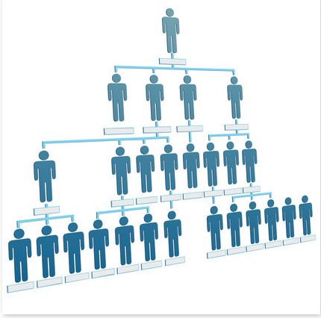
SPAN OF MANAGEMENT
It is also called as span of control or span of supervision.
It refers to the number of subordinates that report directly to a single manager or supervisor.

Slide 41
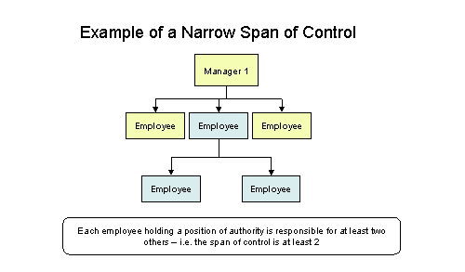
TWO TYPES OF SPAN
NARROW SPAN OF MANAGEMENT
Tall organization.
Manager oversees “few” subordinates.
better communication.
example : handicraft , ivory work , etc.

Slide 42
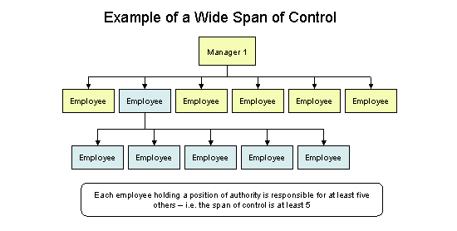
WIDE SPAN OF MANAGEMENT
Flat organization .
Manager oversees “large” number of subordinates.
Less overhead cost.
example: large firms .

Slide 43
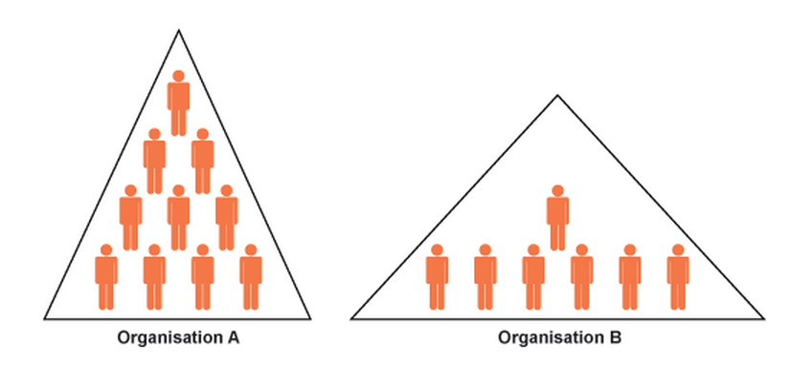
narrow span wide span of control of control

Slide 44
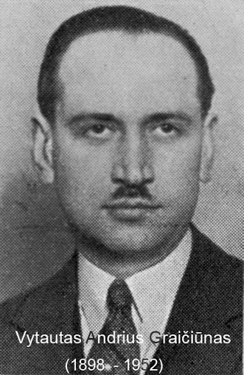
THEORY OF GRAICUNA’S
  He was a French management consultant.
  He developed a formula for analyzing superior subordinate relationship.

Slide 45
THREE TYPES OF RELATIONSHIP
  Direct relationship (superior has direct link with subordinates).
  Direct group relationship(arises between manager and group of subordinates ).
  Gross relationship ( relationship among subordinates).

Slide 46
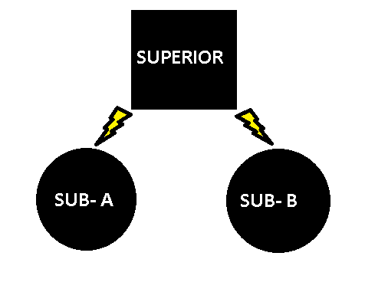
DIRECT SINGLE RELATIONSHIP

Slide 47
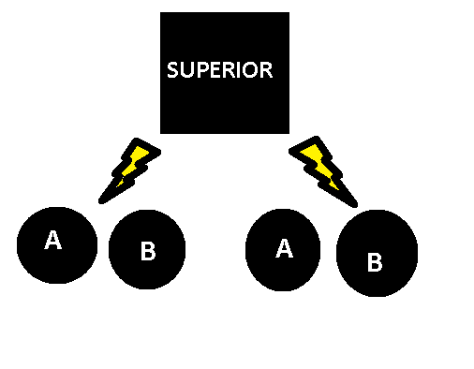
DIRECT GROUP RELATIONSHIP

Slide 48
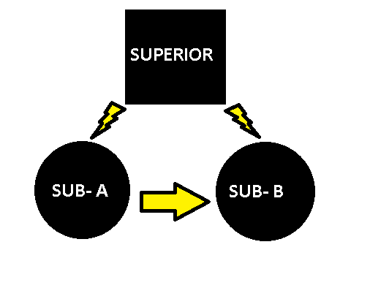
GROSS RELATIONSHIP

Slide 49
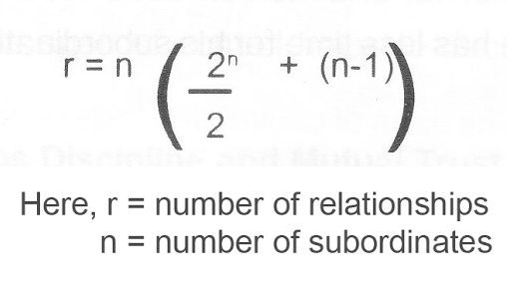
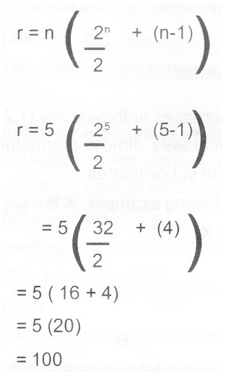
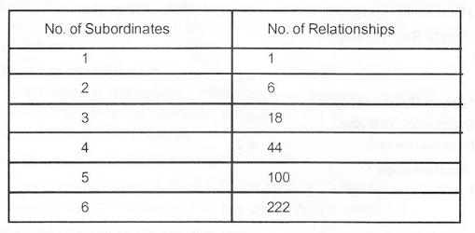
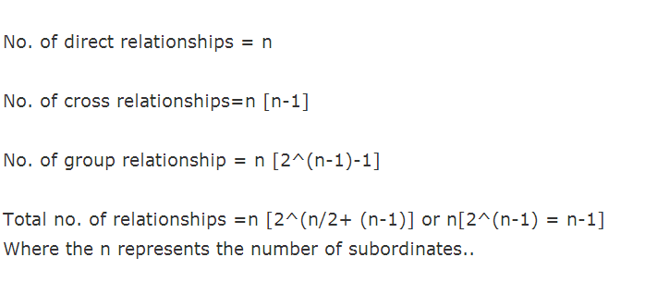
MATHEMATICAL FORMULAS

Slide 50
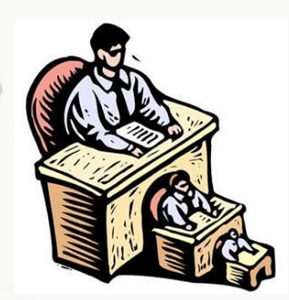
FACTORS DETERMING SPAN OF MANAGEMENT
Nature of work
Type of technology
Ability of the manager
Capacity of subordinates
Degree of decentralization
Quality of planning
Staff assistant
Communication techniques
Time available for supervision
Geographical dispersion of subordinates

Slide 51

DEPARTMENTATION
It is a process of grouping individual jobs into departmentation.
TYPES:
Departmentation by function.
Departmentation by products.
Departmentation by territory.
Departmentation by customers.
Departmentation by process.
Departmentation by time and numbers.

Slide 52
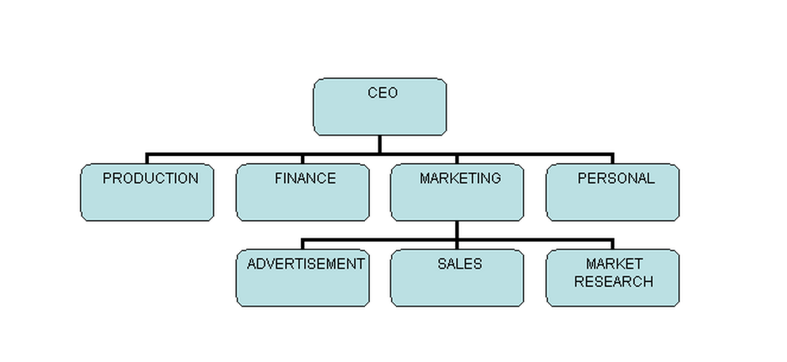
Departmentation by FUNCTIONS
  Deparmentation done by the functions.

Slide 53

MERITS & DEMERITS
Provides scope of specialization.
Eliminates cost of duplication of work.
Effective control over performance.
Facilitates delegation of authority.
Interdepartmental conflicts.
Difficulty in coordination of activities.
Increases responsibility of departmental heads.

Slide 54
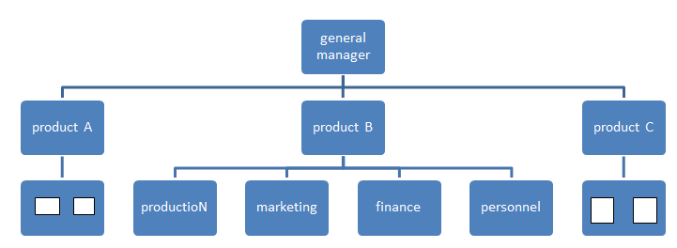
DEPARTMENTATION BY PRODUCTS
It is suitable for different lines of products.

Slide 55
MERITS & DEMERITS
Reduces problem of coordination.
It leads to specialization.
Performance evaluation can be done easily.
It is flexible and adaptable to change .
Chance of duplication is more.
There may be underutilization of plant capacity when the demand of product is not adequate.

Slide 56

TERRITORIAL Departmentation
Used for large scale enterprises whose activities are geographically spread over.

Slide 57
MERITS & DEMERITS
It helps in achieving benefits of local operation.
Better coordination of activities.
Provides effective span of control.
Opportunity to train managers.
Facilitates expansion of business to various regions
Due to geographical distance problem of communication.
Coordination and control becomes less effective.

Slide 58
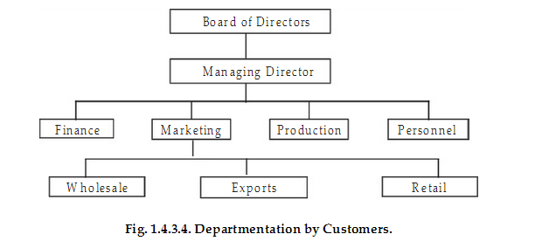
Departmentation By Customers
Each department will serve the particular type or class of customers.

Slide 59
MERITS & DEMERITS
Offer scope of specialization.
Enterprise gain ultimate knowledge about needs of various categories of customers.
Lead to duplication of activities.

Slide 60

DEPARTMENTATION BY PROCESS OR EQUIPMENT
The activities are grouped according to process or equipment.
It is generally used in manufacturing industries.
Lead to specialization.
No confusion.
Proper utilization of manpower and machine engaged in proper way.

Slide 61
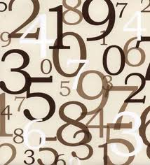
TIME AND NUMBER
DEPARTMENTATION
TIME:
The activities or group on basis of time
EXAMPLE: Call centers or any factory.
NUMBER:
The activities or group on basis of performance by certain number of persons.

Slide 62


